Slide 1
VENDORS IN PANDEMIC
We would die of Hunger rather than dying of Corona.
- Ram Naresh Verma (Street vendor Mukharjee Nagar Delhi)
Presented By:
Nishant Kumar Upadhyay

Slide 2
Introduction
Why we do this survey?
Vulnerability
Inequality and Exclusion
Challenging and opposite time of pandemic for their life
Government policies and action

Slide 3
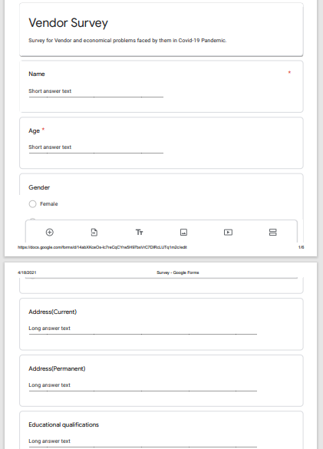
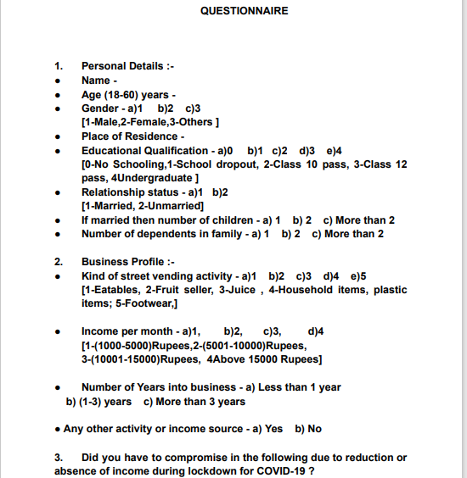
Methods and Questionnaire
Interview is major method used in this research to collect primary data for analyzing the financial and social situation of vendors in this pandemic time.
Questionnaire is in both form offline and online to approach everyone in this covid pandemic period as much as possible.

Slide 4
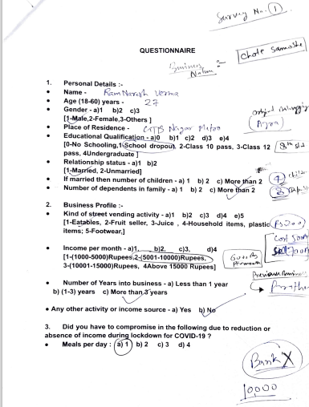
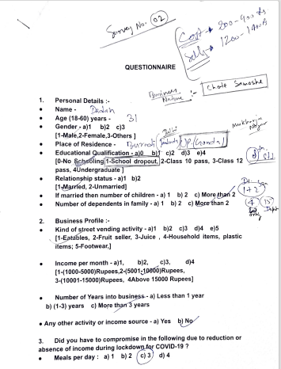
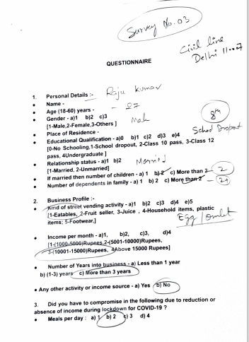
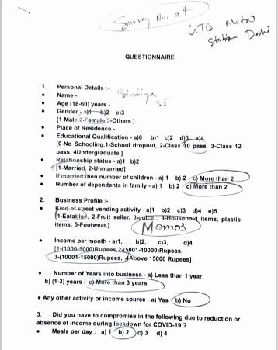
Responses on survey questionnaire
Here are some survey questionnaire with responses.
Questionnaire Includes:
Personal Details
Business profile
Credit and financial profile in covid
Life and personal experiences in covid pandemic.

Slide 5
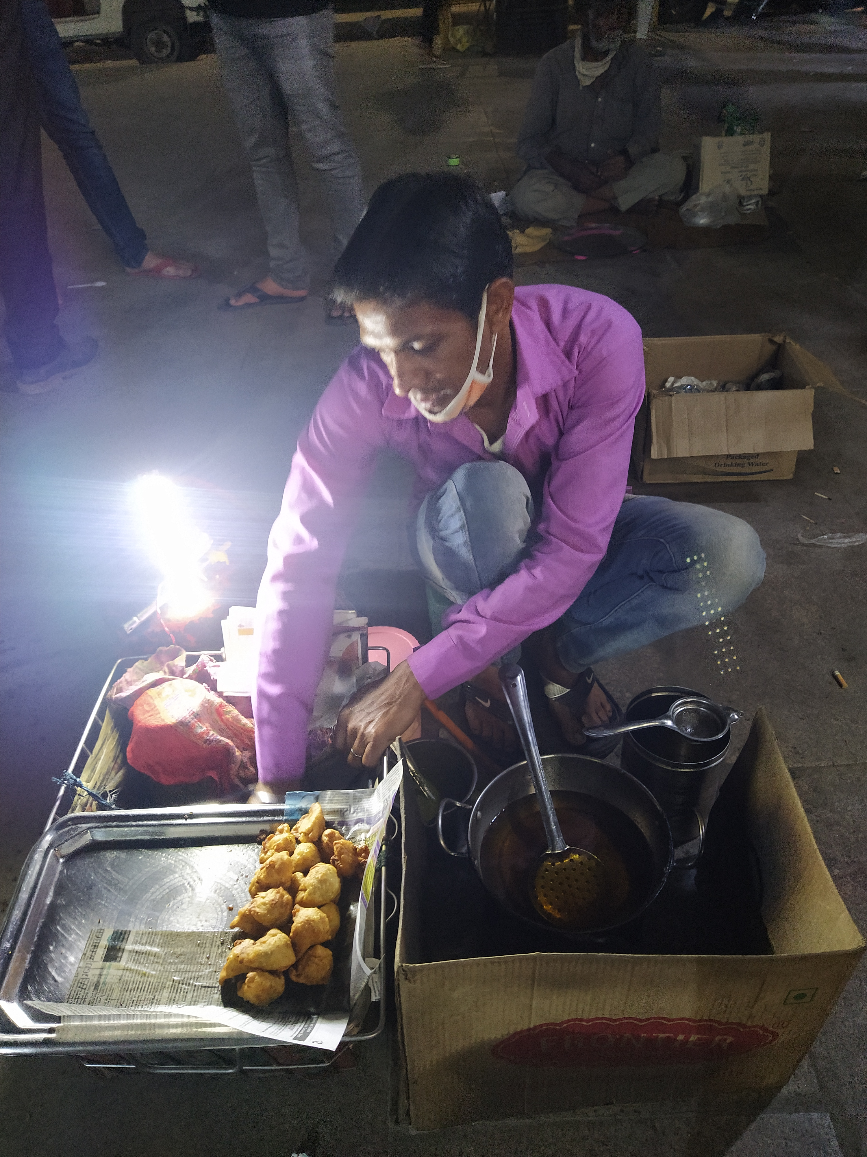
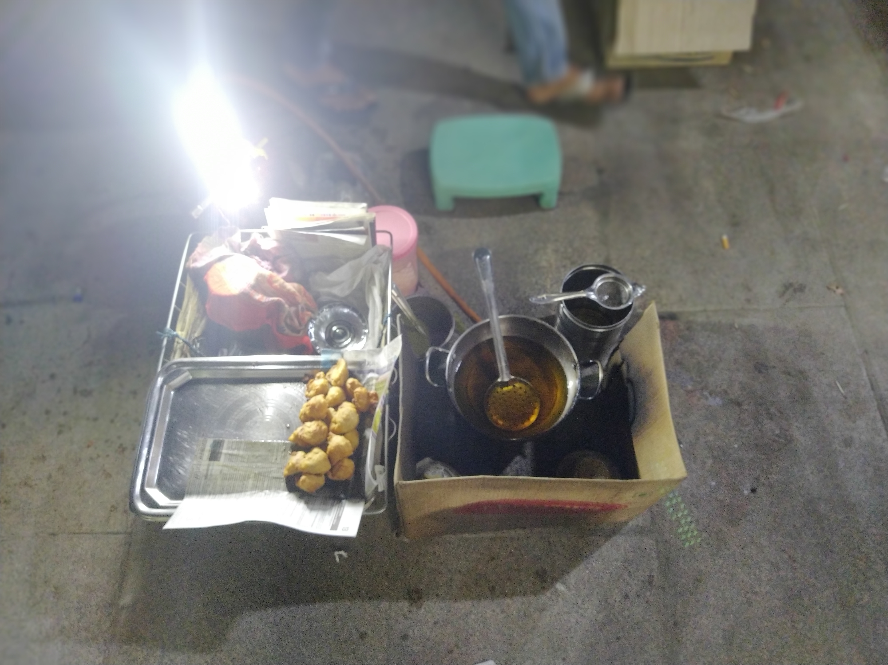
Key Observation And Results
1
Financial crisis in the life of vendors.
2
Personal and social crisis.
3
Exclusion by state or government.

Slide 6
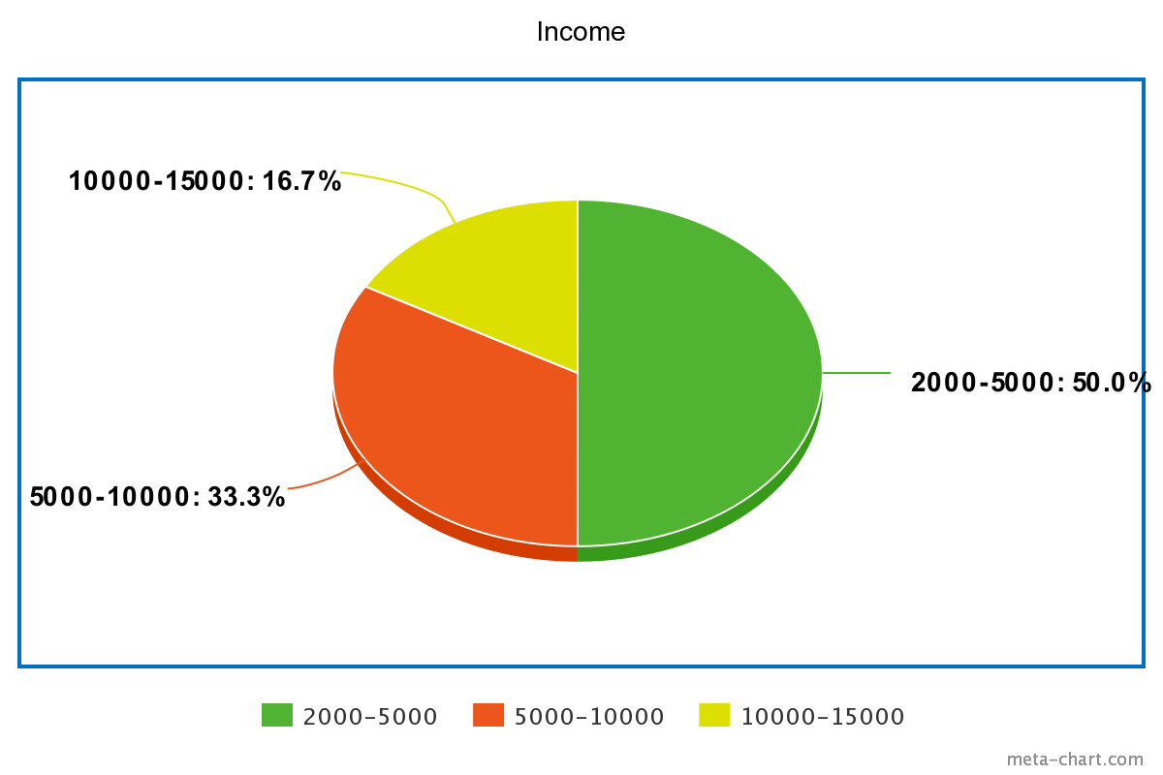
Financial Crisis
Daily Earning is the process to sustain the life of vendors and their family.
In covid pandemic where vendors has no savings facing financial crisis in their life, due to less customers visit income reduced and lockdown impacted much more on financial status of vendors.
Due to need, they went for credit and loan to subsistence of life, where result of informal credit borrowing is 100%.
Mostly informal borrowing is from relatives and friends where they don’t have to pay interest.
INCOME RANGE OF RESPONDENTS

Slide 7
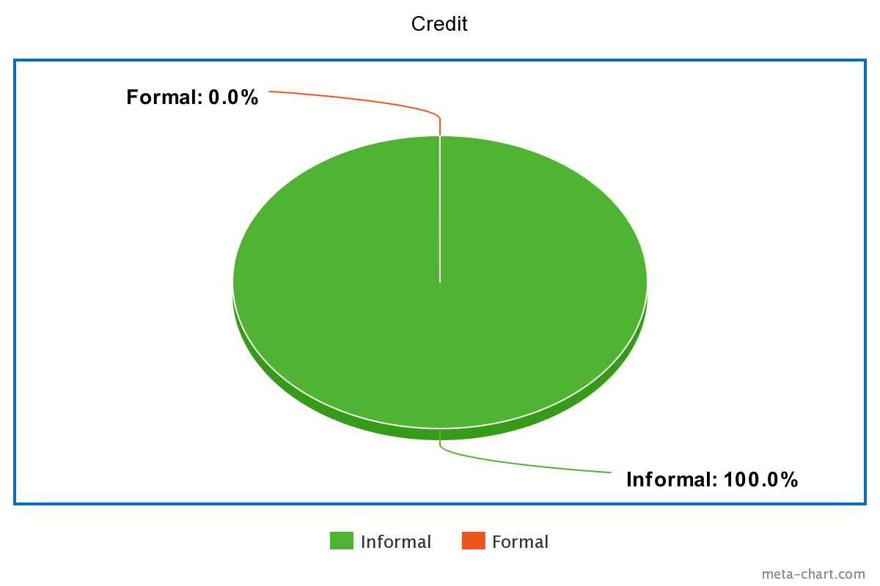
Financial Crisis
Problems with Formal loan: Complex system, Time consuming, collateral, No saving.
Informal loans are taken from friends and relatives which is more easy and no interest rate. (Range of 10000-20000 Rs. Credit taken from informal credit)
Profit: Profit is very minimum during the time of covid the average profit is around 3500 Rs.
Credit Type

Slide 8
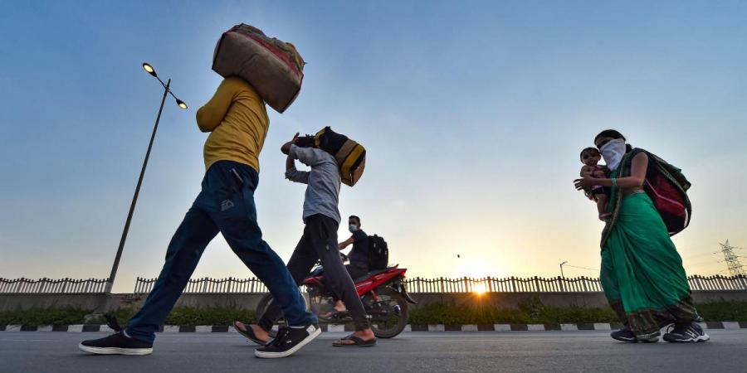
Social and Personal Crisis
Increased Inequality
Nutritional problems to these groups
Educational problems to their children
Migration

Slide 9
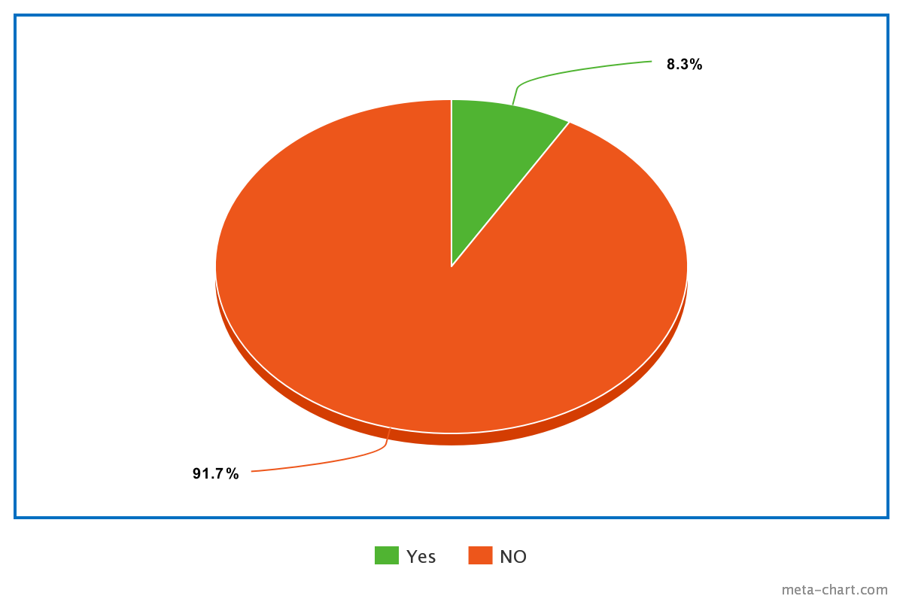
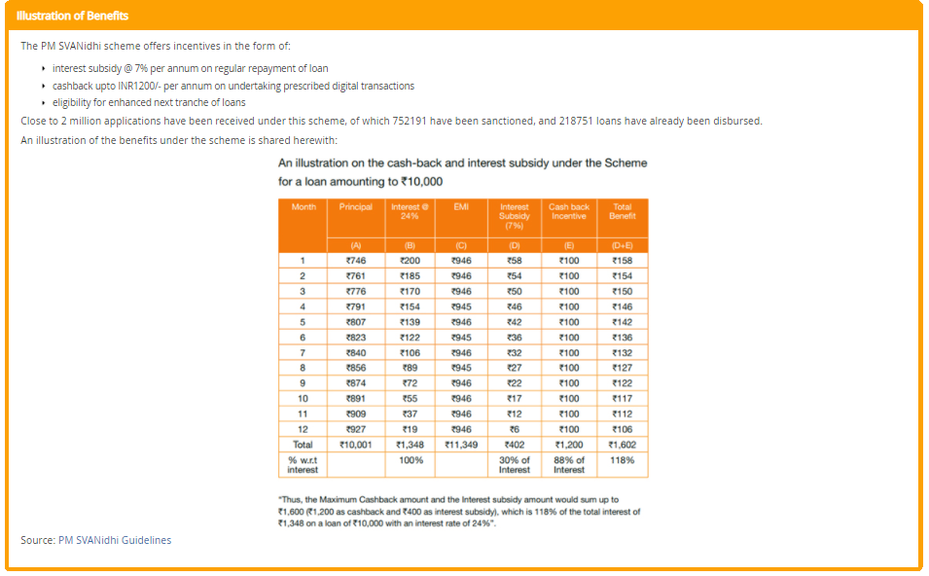
Exclusion By State or Government
State launched PMSvanidhi Yojana in pandemic to recover this challenging time. But in our survey 91.7% have not even heard the word of this scheme.
Lack of implementation and exclusion by state is clearly seen.
As of now total 20 Lakh application received but only around 2.5 lakh loan disbursed as per the GOI data.
This microcredit scheme is not micro but nano.
Response on PMSVANIDHI scheme

Slide 10
Critical Analysis of Survey
PMSVANIDHI Scheme, under the scheme vendors can avail formal loan of 10000 without collateral, but in reality disbursement of loan is on the fake name, which means even who is not vendor got loan.
Real beneficiaries even outreached by this scheme.

Slide 11
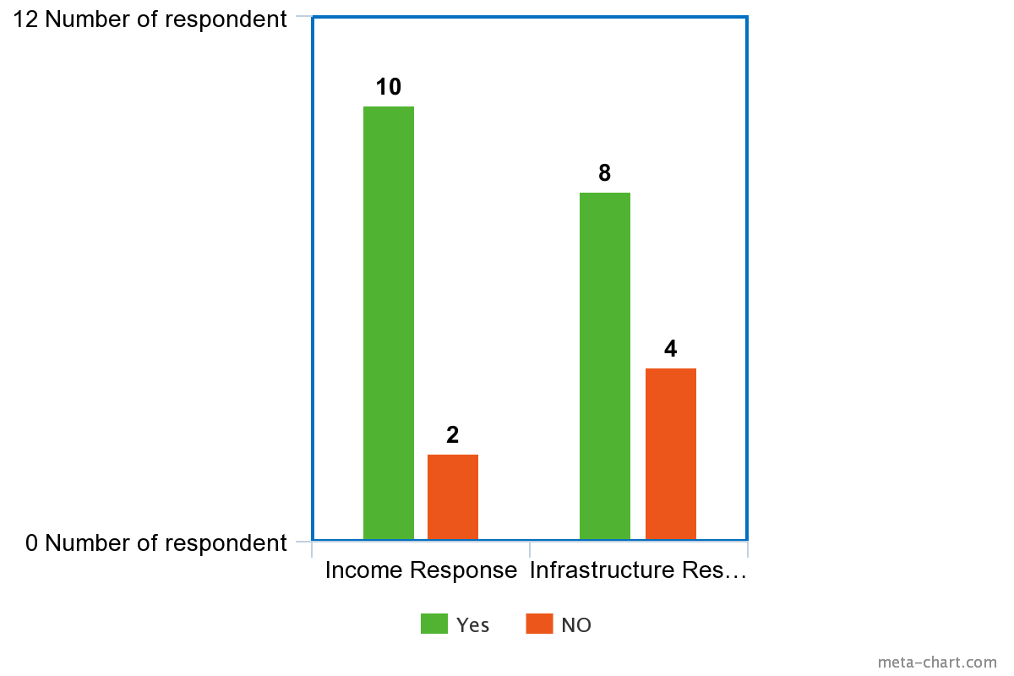
Critical Analysis of Survey
As we can find out through the graph, cause for most of the migration towards urban area because of income and infrastructure.
Enticing Infrastructure: respondent argue that infrastructure in urban area entice them, but in actual sense it is trap net for them, because even so many year of business in metropolitan city they don’t have enough money to use these enticing infrastructure once.

Slide 12
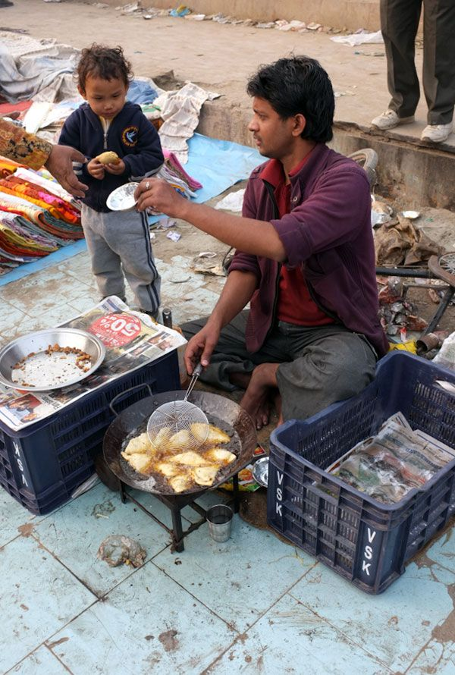
Thank You
Poverty is the Worst form of Violence.
A Nation’s Greatness is measured by how it treats its weakest members.
- M.K. Gandhi
Notes:
In Slide Show mode, select the arrows to visit links.

